Slide 1
Creating abundance together
Soma Stout, MD MS Executive Lead, 100 Million Healthier Lives
Institute for Healthcare Improvement
Stakeholder Health Webinar

Slide 2
Our time together
Share a little bit about my journey
Why place matters in population health
The 100 Million Healthier Lives challenge
Journey to population health for health care systems

Slide 3
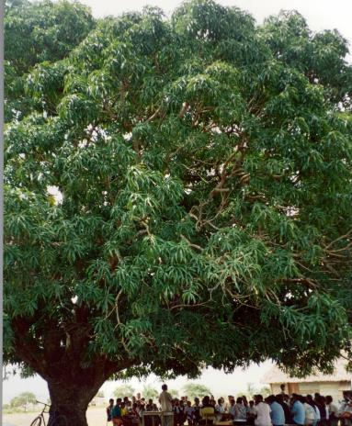
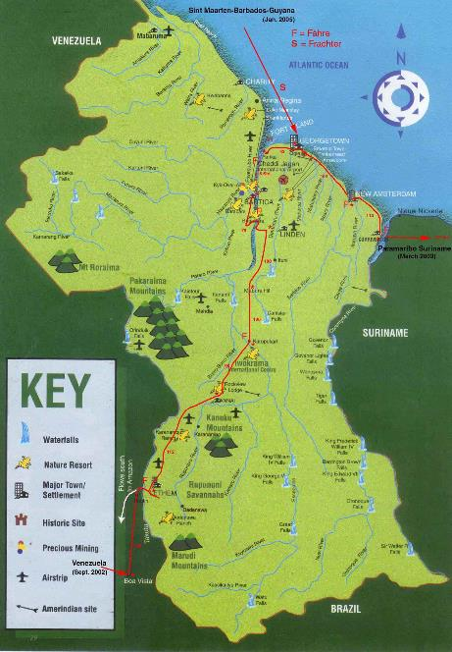
Varqa Foundation, Rupununi Region of Guyana
16,000 people
33,000 sq miles
No roads, communication, electricity
5th grade education
Subsistence economy

Slide 4
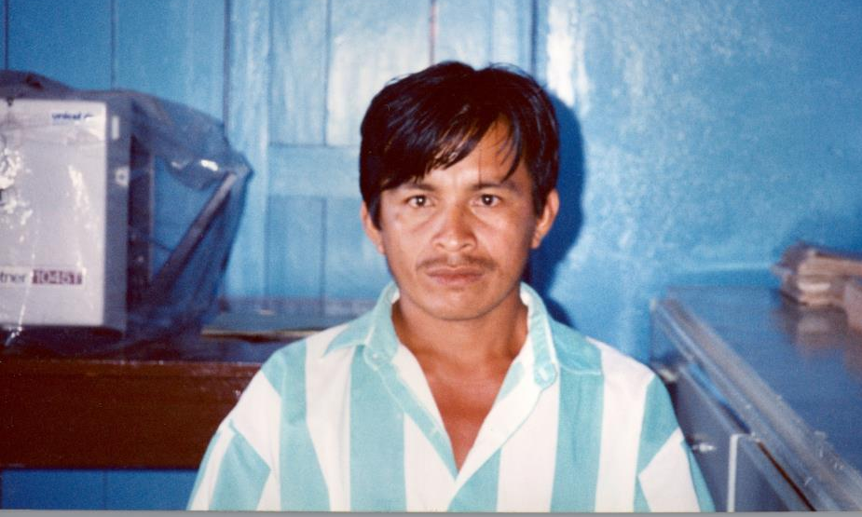
Unlocking the trapped and untapped potential of people

Slide 5
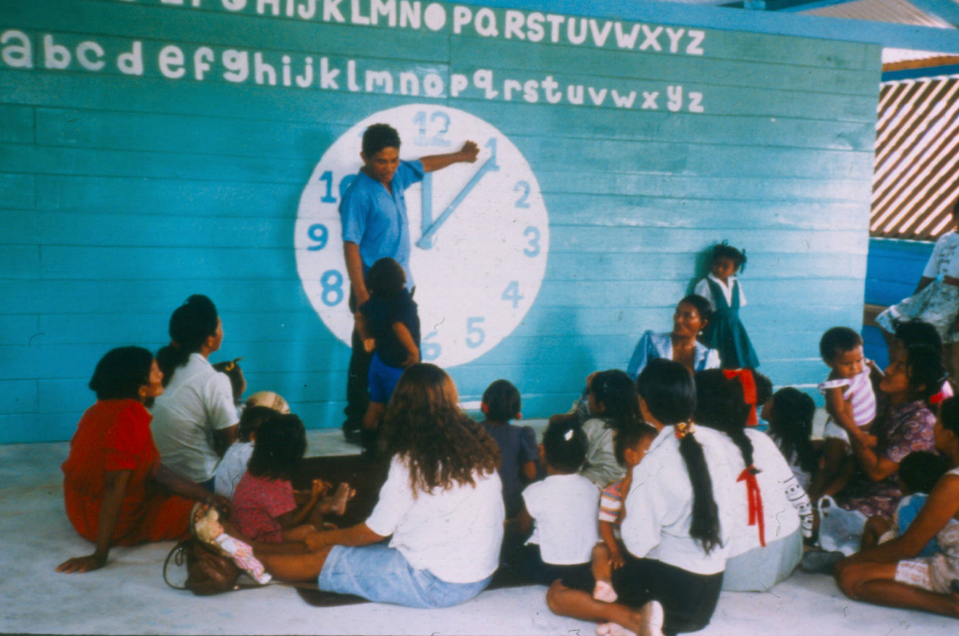

Slide 6
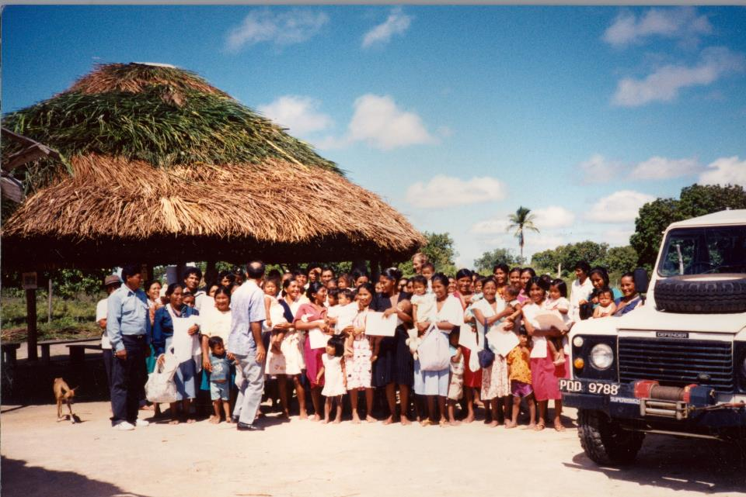
A Powerful Way of Being and Doing
From “me” to “we”
From isolation to interconnectedness
From pathology to vision
From poverty to potential
From scarcity to abundance
From having answers to asking questions
From perfect planning to learning and failing forward
Embracing system transformation

Slide 7
Interrelationship between people, places and systems
People
Systems/ Society
Places
Health, wellbeing and equity

Slide 8

Cambridge Health Alliance (CHA)
Customers
(50% speak language
other than English
70% publicly insured)
Trainees
(actively engaged
in creating
transformation)
Public health
Integrated care
delivery system serving
100,000 patients
(12 community clinics, 2 hospitals, 3 EDs, specialty sites)
Community
(7 cities)
3393 Employees
(in 18 labor unions)
“Whose life got better because we were here?”

Slide 9
Cambridge Health Alliance Experience
Changed our payment model and our delivery model from fee for service to global payments (230 people to 60% population)
Improved experience
10% reduction in total cost (15% reduction compared to rest of network for Medicaid managed care)
Improved quality health outcomes for a safety net
population to above the national 90%ile
Improved joy and meaning of work for the workforce

Slide 10
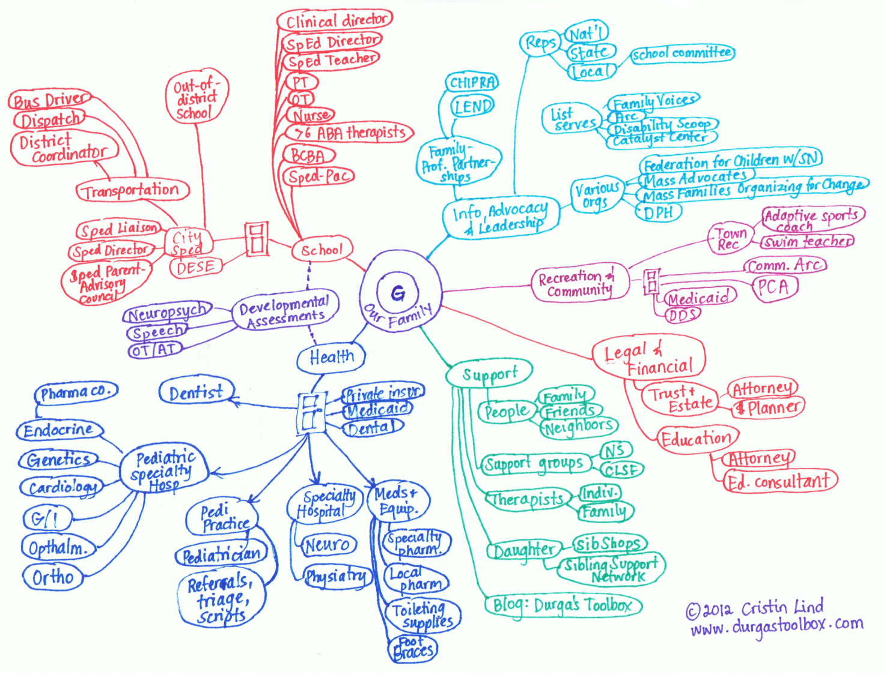

Slide 11
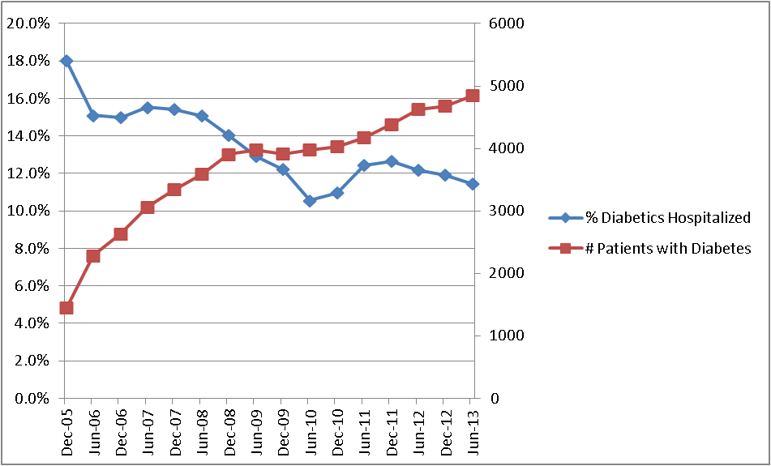
36% Reduction in Hospitalization Rate for Patients with Diabetes
The 5000:1 challenge

Slide 12
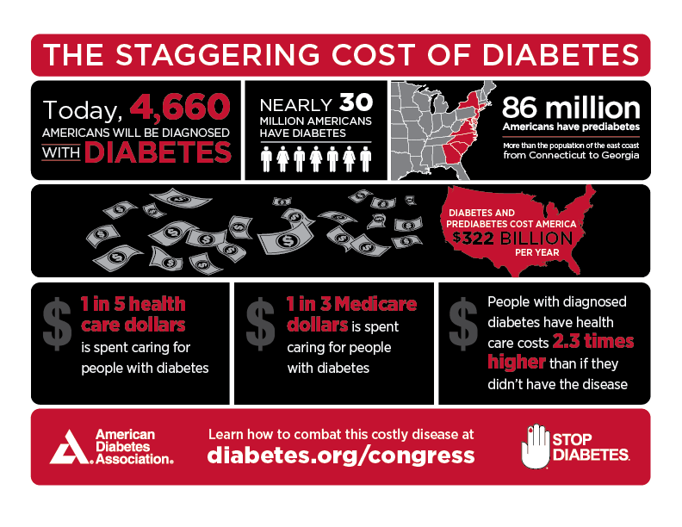
Cost of inequity and its impact on chronic disease is unsustainable

Slide 13
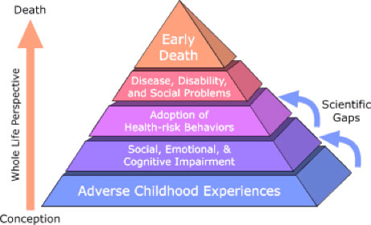
The need for a life course view
Exposure to toxic stress in early childhood may lead to as much as a 40x increase in rate of chronic disease by the time you’re 50.

Slide 14
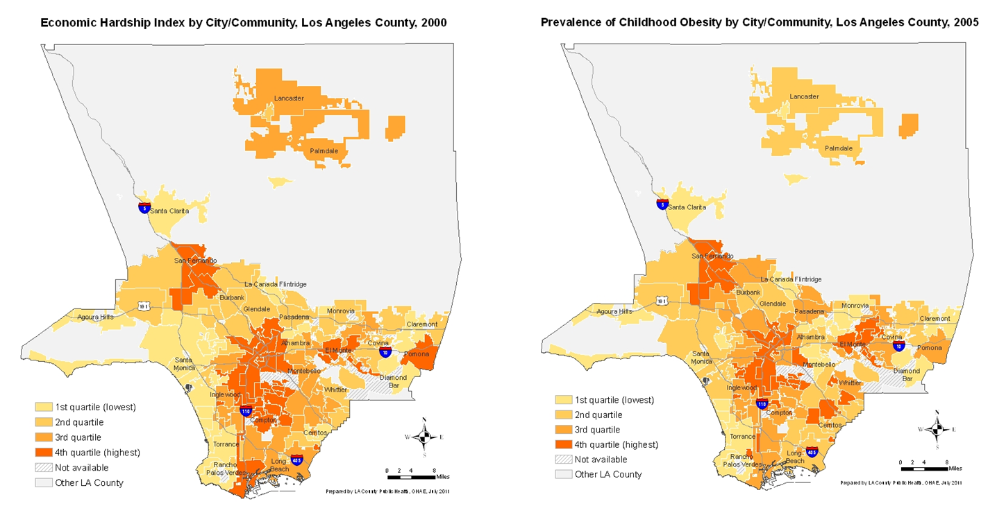
Health and Social Inequity are Interconnected
2 newborns will have a 25 year gap in life expectancy 2 miles apart
based on where they grow up

Slide 15
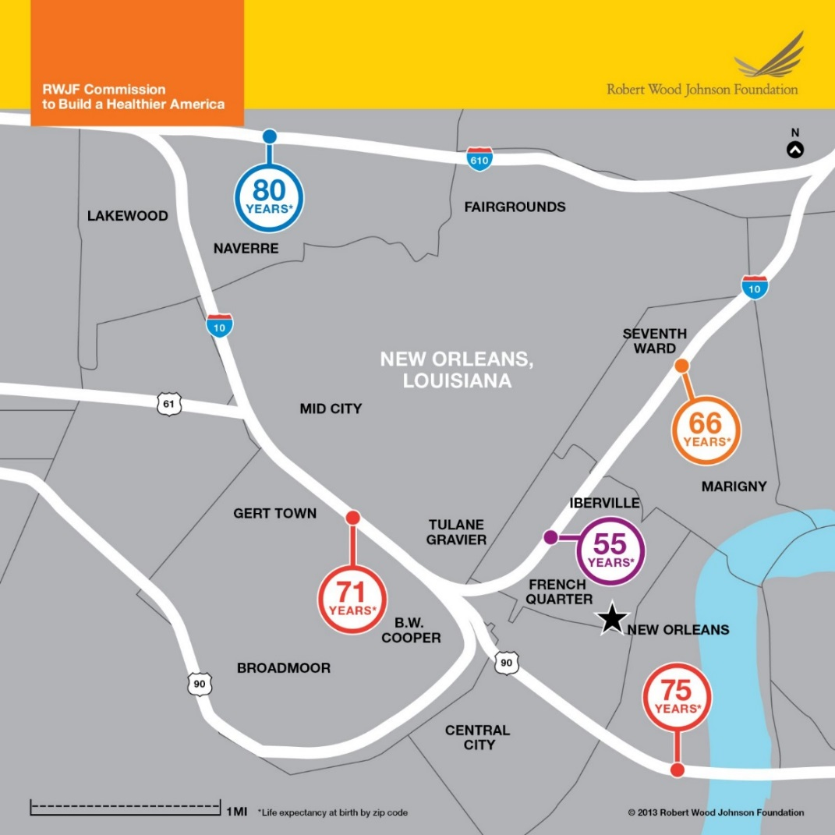
Equity as a System Property
2 miles
25 year gap in life expectancy

Slide 16
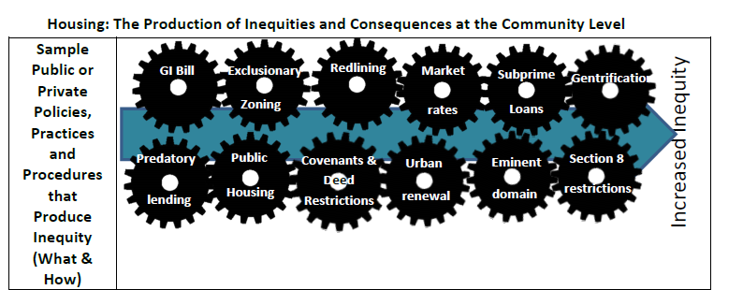
Chronic inequities that are place-based are not accidental – there is a system in place that propagates them
Chronic contributors: Racism, Poverty, Gender, Stigma
“What Happened to You?” Report from the Prevention Institute

Slide 17
5 key shifts we need to make
From a “health care system” to a “health and wellbeing system”
Take our work on equity from “doing good” to a recognition that we are interconnected and cannot afford the price of poverty and inequity in terms of health outcomes or health care cost
From scarcity to abundance
From pathology to vision – change is possible
From communities of poverty to communities of solution

Slide 18
100 Million Healthier Lives
Who: An unprecedented collaboration of change agents pursuing an unprecedented result:
100 million people living healthier lives by 2020
Vision: to fundamentally transform the way we think and act to improve health, wellbeing and equity.
Equity is the price of admission.
www.100mlives.org
Notes:
Learning community

Slide 19
Theory of Change – 100 Million Healthier Lives
Unprecedented collaboration
Innovative improvement
100 Million People Living Healthier Lives by 2020
System transformation

Slide 20
Asking generative questions
Unprecedented collaboration
What could we do together that we couldn’t do alone?
Innovative improvement
Whose lives are going to get better because we were here?
Equity as the price of admission
Who isn’t thriving?
System transformation
What would it take for that to change?

Slide 21
What we do to get to 100 million healthier lives by 2020
Build a thriving, joyful movement to create a culture and practice of health and wellbeing for all.
Build capacity and relationships within and among change leaders at every level
Support collaborative improvement and the spread and scale of bright spots.
Support health and wellbeing for those who aren’t thriving.
Create the connecting, catalyzing trellis support for the movement.
Create enabling conditions and mindsets to transform culture and system.

Slide 22
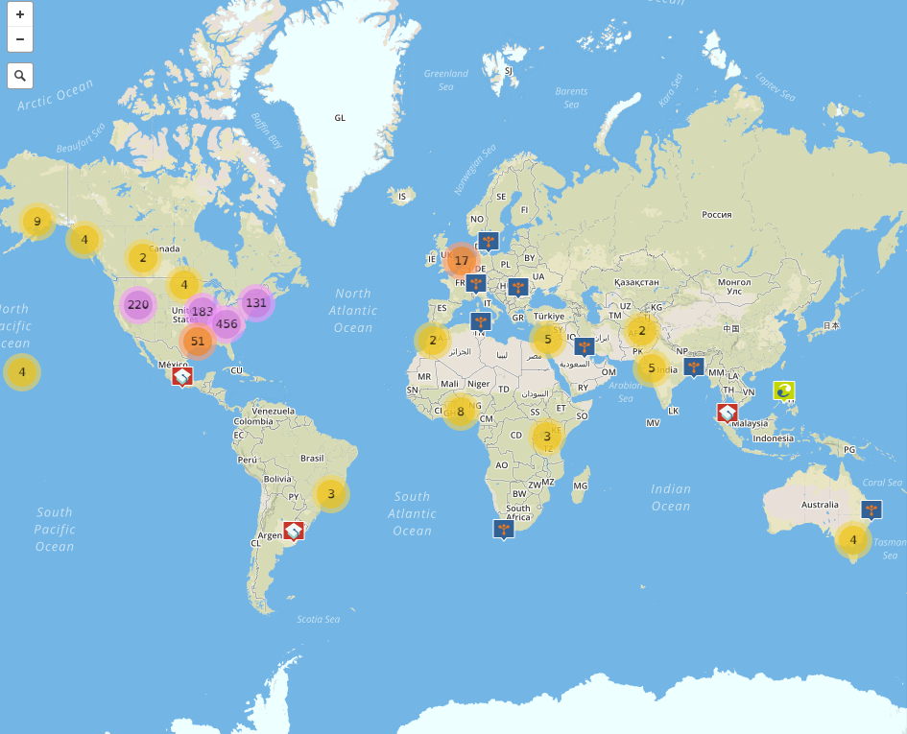
A growing movement: >830 members in 15+ countries worldwide – will you join us?
Notes:
In the time since we launched in October of 2014, the movement has welcomed to over 800 members in more than 15 countries worldwide, and growing.
This screenshot is from our interactive Map of the Movement, a tool that our partners at Community Commons built, where anyone can see WHO is a part of 100 Million Healthier Lives, WHERE in the world they are working, and WHAT are the specific “pieces of the puzzle” they are working on to create health, wellbeing, and equity.

Slide 23
6 Core Strategies
Develop healthy, equitable communities
Create bridges between sectors
Create a health care system that is good at health and good at care
Scale up peer to peer supports
Develop new culture and mindsets
Create enabling conditions

Slide 24
Shared Priorities http://www.100mlives.org/approach-priorities/
“Whats”
“Hows”
Close equity gaps (price of admission)
Develop communities of solution
Help veterans to thrive
Address social determinants
Improve well-being of indigenous communities
Help all kids thrive from cradle to career
Make mental health everybody’s job and take a prevention approach
Engage people in healthy living (nutrition, exercise, sleep, stress)
Use chronic diseases and risk factors to build the health continuum
Create well-being in the elder years and end of life
Shift culture and mindset
Develop the health workforce
Elevate peer to peer approaches
Build improvement capability at the community level
Engage businesses to create wellbeing in their employees and their communities
Engage faith communities as health creators
Improve high quality primary health care access for all
Integrate data across siloes
Create new financing strategies
Transform from a health care system to a health system
Notes:
When someone joins 100 Million Healthier Lives, they share with us what their piece of the puzzle is, what it is that matters to them to meaningfully improve health, wellbeing and equity where they are and for whom they serve.
When the initiative was formed, the priority areas of the 600 or so founding members aligned with the categories on this slide, what we call the “9 whats” and “9 hows.” So we’re a big tent and intentionally so.
Members are working on a vast array of specific topics and challenges – and we believe that is necessary to achieve our bold aim. Part of the “unprecedented collaboration” piece is that there are groups of leaders helping to organize and be examples of progress in each of these priority areas… if anyone on the line is passionate about one and wants to learn more or get involved, we invite them to do so!
So that’s the big tent—LOTS of topics.

Slide 25
Shaping the path: health care
Portfolio1: Patient physical and mental health
Portfolio 2: Patient social and spiritual wellbeing
Portfolio 3: Community health and wellbeing
Portfolio 4: Communities of solution
Engage people with lived experience, promote equity

Slide 26
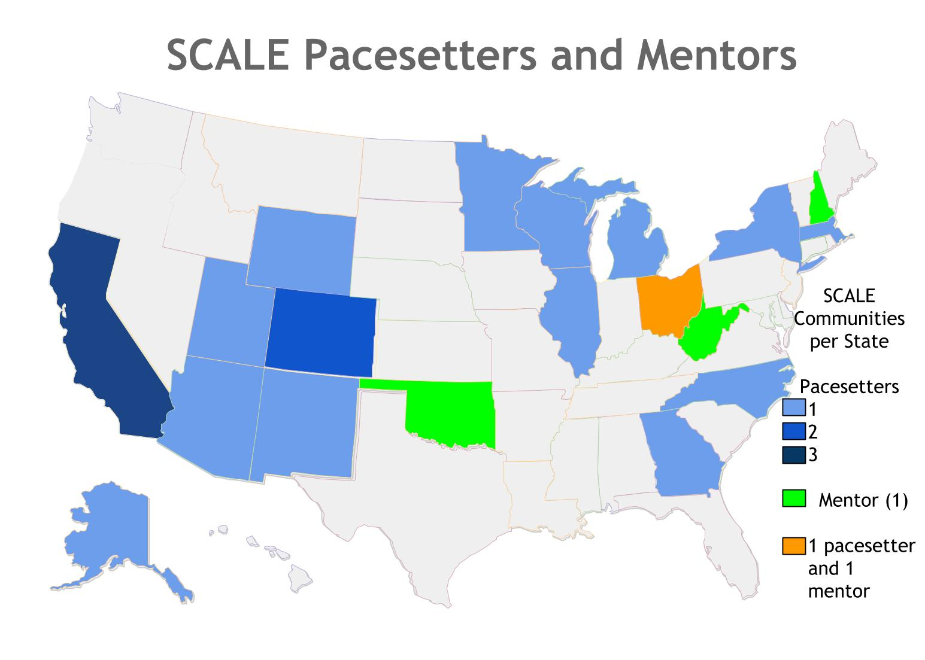
SCALE-ing the ways of being and doing
24 communities → 75 communities → 250 → 1000 communities → 5000 → 10,000 communities

Slide 27
Leading for Abundance – Ways of being and doing
Leading from within
Leading together
Leading for outcomes
Leading for equity

Slide 28
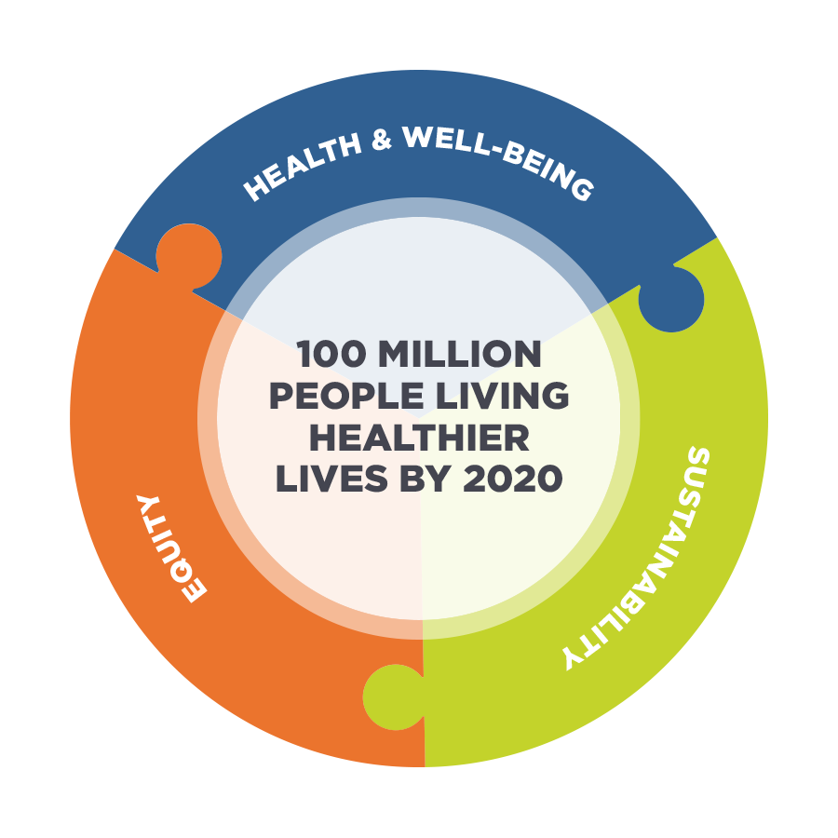
Our Measurement Framework

Slide 29
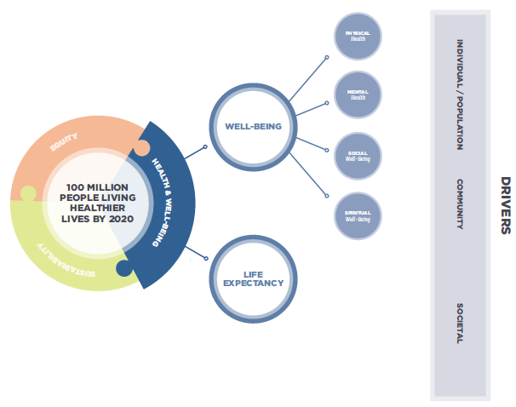
Health & Well-being
PHYSICAL
HEALTH
MENTAL
HEALTH
SOCIAL
WELL-BEING
SPIRITUAL
WELL-BEING
Notes:
Well-being is a broader construct than health, with health as both a component of and a determinant of well-being. Health is necessary but not wholly sufficient to achieve well-being.

Slide 30
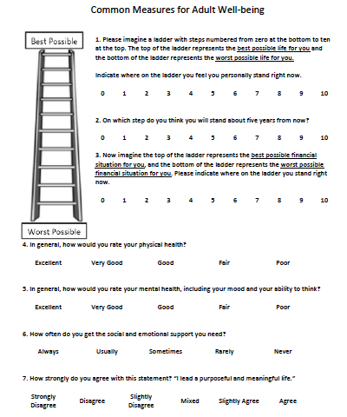
Overall well-being
Social
Physical
Mental
Social
Spiritual

Slide 31
Measuring Health and Wellbeing
Increase in % of people thriving
Decrease in % of people who are struggling
Well-being x Life Expectancy =
Well-being Adjusted Life Years (WALYs)
Notes:
We defined healthier lives in terms of well-being adjusted life years (WALYs) as a composite measure that incorporates both the quality and quantity of life, with the unit of 1 WALY defined as one year of life lived in perfect well-being.

Slide 32
Measures of health and wellbeing at multiple levels
People
Systems of Society
Places
Health, wellbeing and equity
Notes:
Can we create measures of physical, mental, social and spiritual wellbeing at the level of the community and society?

Slide 33


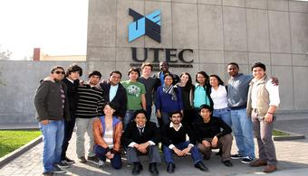
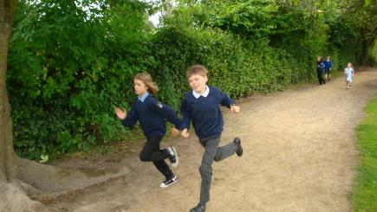
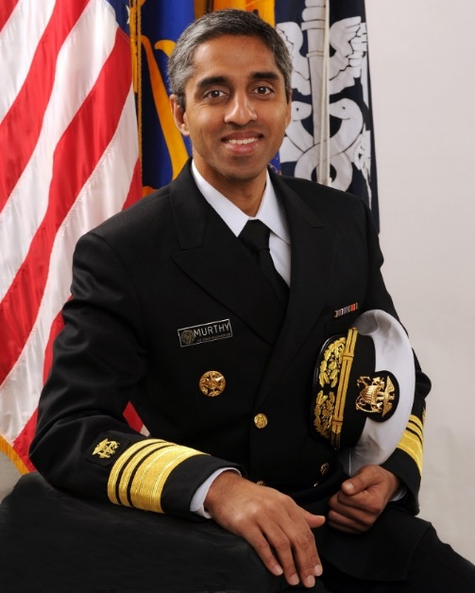
https://vimeo.com/83703623
UTEC
St Ninian’s
https://www.utec-lowell.org/gallery/video

Slide 34
Leading from abundance
Abundance does not happen automatically. It is created when we have the sense to choose community, to come together to celebrate and share our common store. Whether the scarce resource is money or love or power or words, the true law of life is that we generate more of whatever seems scarce by trusting its supply and passing it around. Authentic abundance does not lie in secured stockpiles of food or cash or influence or affection but in belonging to a community where we can give those goods to others who need them—and receive them from others when we are in need.
Parker Palmer, Let Your Heart Speak

Slide 35
What could we do together that we couldn’t do alone?
How might we work together to help 100 million people to thrive across thousands of communities across the world?
Contact info:
www.100mlives.org
@100MLives
100MLives@ihi.org

